Slide 1



Does Happiness impact Life Expectancy, what impacts Happiness and Life Expectancy?
Exploring the Relationship through Data Visualization
Paula Beckett, Juanita Sands, Joey Zheng, Cameron DIFalco
Notes:
Cameron –
Hi All, Today our group will be discussing the connection between happiness and life expectancy, and more importantly how each variable effects the other. We all have a different focus for this presentation to offer a holistic approach to the presentation.

Slide 2


Purpose of the Presentation
The purpose of this presentation is to draw a conclusion on how the two variables happiness and longevity can affect the other, and from a statistical perspective, is there any correlation?
Previous studies on this topic have provided mixed and sometimes biased results, we are conducting a comprehensive analysis using multiple data sources to provide a holistic approach.
Our goal is to provide you with a clear and concise answer to answer the question - how your happiness can impact your ability to live a long and fruitful life.
Our First Thoughts On What Impacts Happiness And Life Expectancy?
Happiness
Positive emotions
Lower stress levels
Social support and relationships
Positive lifestyle choices
Life Expectancy
Healthy lifestyle
Access to health care/ disease prevention
Education and knowledge
Mental well-being
Notes:
Cameron
The purpose of this presentation aims to determine the correlation between happiness and longevity from a statistical perspective. Although countless studies have been done on this topic, we are bringing some fresh eyes to the topic and hope to uncover the truth. We will be using multiple data sources to reach the goal of providing you with a clear and concise answer regarding how happiness can potentially influence your ability to live a long and fulfilling life.
Various factors can impact an individual's happiness. These factors include experiencing positive emotions, maintaining lower stress levels, having social support and strong relationships, and making positive lifestyle choices. Positive emotions contribute to overall happiness, while lower stress levels can enhance well-being. Additionally, having a strong social support system and meaningful relationships can significantly contribute to one's happiness. Lastly, making positive lifestyle choices, such as engaging in healthy habits and activities, can also have a positive impact on overall happiness.
Several factors can influence life expectancy. Maintaining a healthy lifestyle, which includes engaging in regular exercise, eating a nutritious diet, and avoiding harmful habits like smoking, can positively impact longevity. Access to quality healthcare and effective disease prevention measures are also crucial factors that can extend life expectancy. Furthermore, education and knowledge play a significant role in promoting healthier lifestyles and making informed decisions about health. Lastly, prioritizing mental well-being and seeking appropriate support and treatment for mental health conditions can contribute to a longer and healthier life.

Slide 3
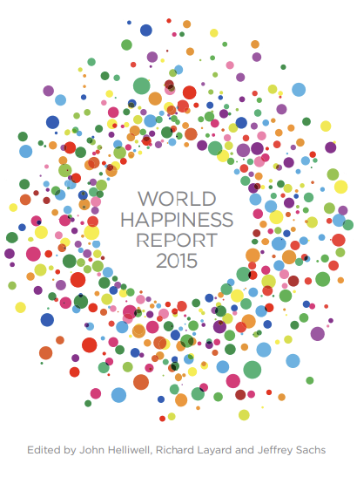
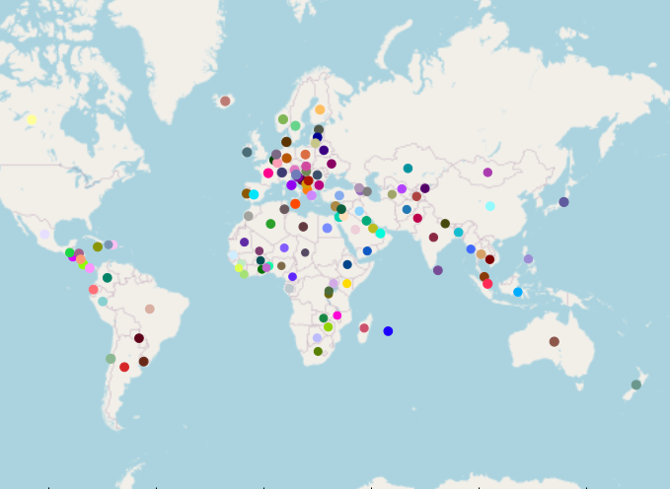
Our Data Sets
The World Happiness Report 2015
The Gallup World Poll is an annual report that commenced in 1938 and in 2023 a conducted annually, growing since the first international survey done in 1938.
The survey reached 160 countries last year is carried out both face-to-face and by telephone and in over 140 languages.
Using this Gallup World Poll, the United Nations’ Sustainable Development Solutions Network generated the World Happiness Report which looks beyond things like GDP to discover how people are feeling about their lives.
World Health Organisation – Life Expectancy Report
In 2015 there were 183 countries with data in the WHO Life Expectancy report, of those, 122 were included on the World Happiness Report.
Typical annual sample size is 1,000 people per country per year.
Responses from 3yrs are used, giving a dataset of 3,000 people per country.
The Six Key Variables to Our Report
GDP per capita
Social Support Trust
Freedom
Schooling
Healthy years of life expectancy
Generosity
Notes:
Paula notes:
Quote from WHR website: The World Happiness Report reflects a worldwide demand for more attention to happiness and well-being as criteria for government policy
Gallup World Poll started 1938.
World Happiness Report started 2012
2023 data = typical annual sample size is 1,000 people per country. Responses from 3yrs are used giving 3000 responses, enough to give a “reasonably good estimate at the national level”

Slide 4
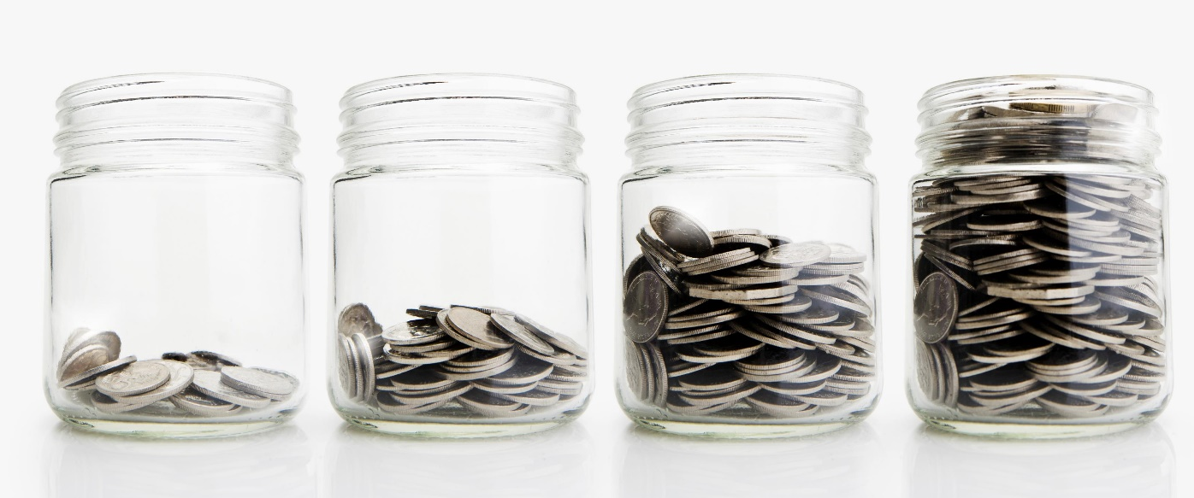


The Impact of Country Wealth on Happiness and Longevity: Does Money Equal Happiness and Longevity?
What is GDP: Gross Domestic Product (GDP) measures the quantity of goods and services produced by a country. GDP per capita (population) provides a measure of standard of living of a country.
Insights
From Fig 1 Null Hypothesis testing
Testing of the null hypothesis supports that a countries GDP positively impacts happiness and long life
This results in countries that are wealthier have longer lives and are happier
Null Hypothesis: Money does not bring happiness or long life. Tested via ANOVA
Happiness: <0.05 Life Expectancy: <0.05
Fig 1. Null Hypothesis Testing
Notes:
Juanita
Now let’s discuss the impact of a country's wealth on happiness and long life. First, let's quickly touch on GDP or Gross Domestic Product. GDP measures the quantity of goods and services produced by a country and GDP per capita is a measure of a country's standard of living.
Now let's look at how GDP affects happiness and long life. We would assume that more money a country has it would lead to improved happiness and longer lives. To test this hypothesis, we performed an Analysis of Variance (ANOVE) as shown in Fig 1. The data in Fig 1 shows that the result consistently declares our null hypothesis void. A country's GDP positively impacts happiness and long life. This means that countries with higher GDP per capita are indeed happier and have longer lives. In conclusion, a country's GDP and wealth can have a major impact on happiness and life expectancy.

Slide 5

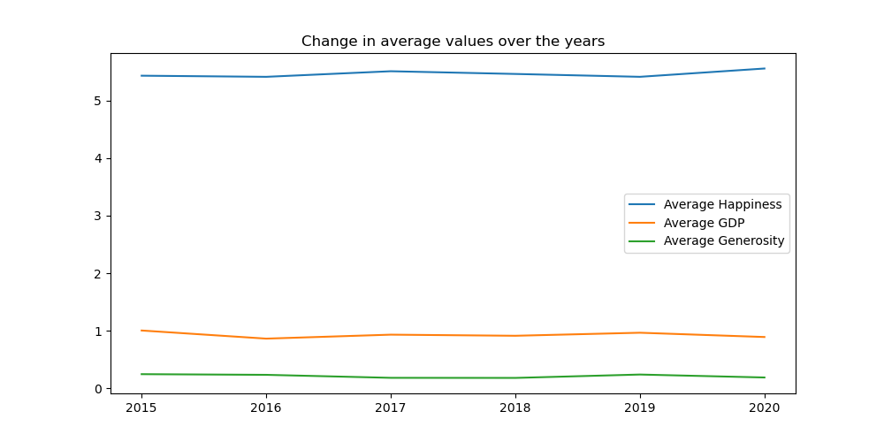
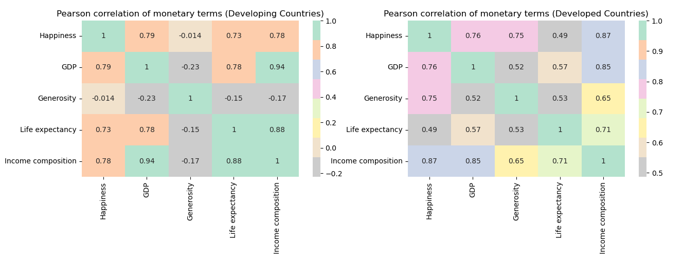
GDP’s Effect on Happiness and Life Expectancy
Fig 2.
Insights
From Fig 2 Change in average value over the years
There has not been any considerable movement in our data from 2015 to 2020.
From Fig 3. Pearson Correlations
Countries that have higher GDP also have higher happiness and long life
Correlation between GDP and happiness is only marginally higher for developed countries compared to developing countries
While the correlation between Generosity and happiness, long life, GDP, income composition only makes an impact on developed countries
Possible Solutions
Countries should ensure they have strong monetary policies to maintain or expand current GDP and Income Composition.
To improve global happiness and long life, wealthier countries could consider supporting developing countries to improve their outcomes.
Fig 3. Pearson Correlations
Notes:
Juanita
Figure 2 analysis the average of happiness, GDP and generosity over the period 2015 to 2020 and shows that there has not been a lot of movement in any of the averages.
Figure 3 looks at the correlations between countries happiness, life expectancy, GDP, generosity and income composition of resources.
Income Composition of Resources measures how good a country is at utilising its resources. It is graded between 0 to 1, and a higher grading indicates optimal utilisation of available resources
The correlations support countries that have higher GDP also have higher happiness and long life; correlation between GDP and happiness is only marginally higher for developed countries compared to developing countries
While the correlation between Generosity and happiness, long life, GDP, income composition only makes an impact on developed countries.
In conclusion, by looking at the insights and possible solutions from the data, it is evident that countries and organisations could target different policies to increase global happiness and long life, but it is more prominent in wealthy and developed countries.

Slide 6
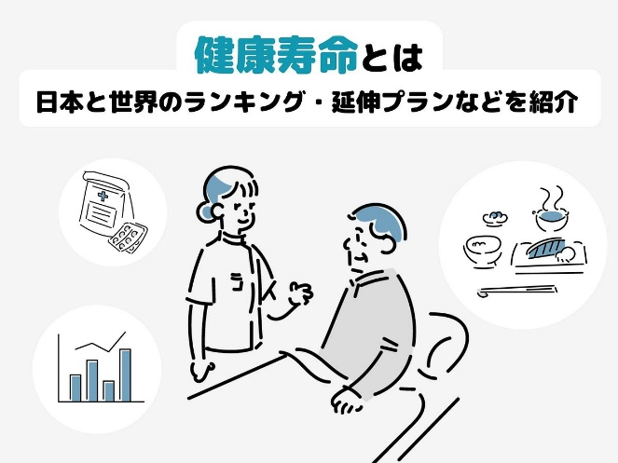
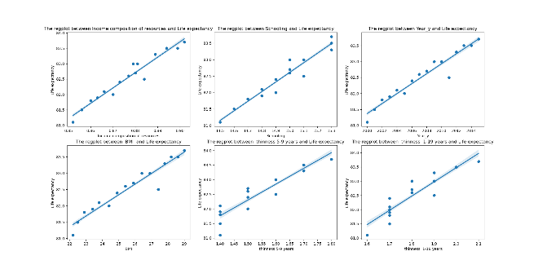
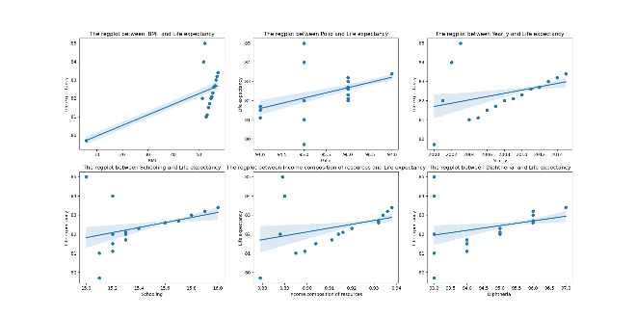
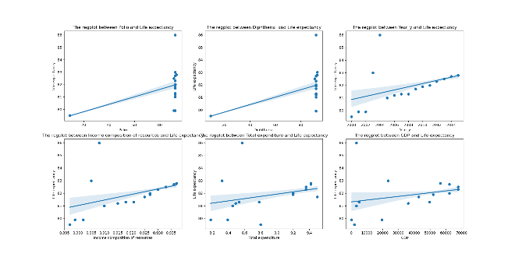
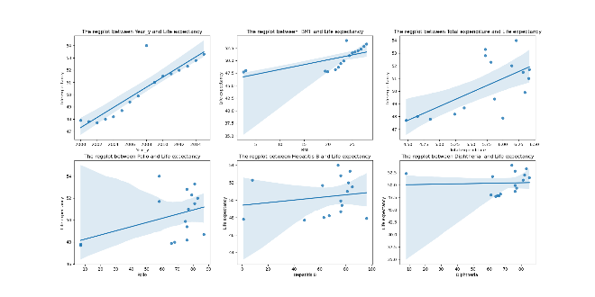
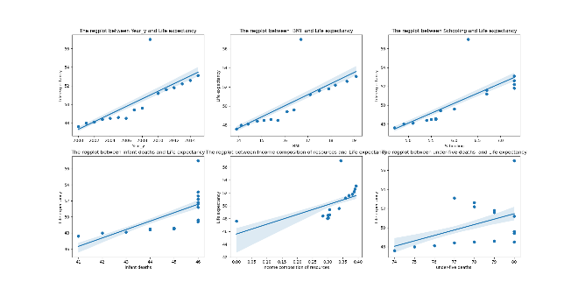
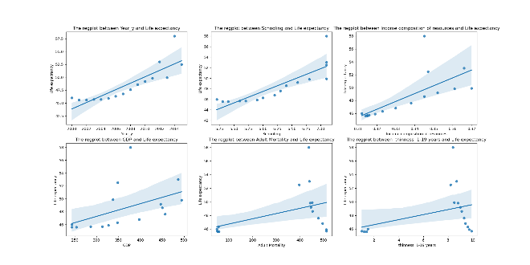
Health Level vs Life Expectancy
Region/Country
- Japan, Australia, Switzerland
Insights
Pick up 3 countries from the Top 10 life expectancy
Pick up 3 countries from Bottom 10 Life expectancy
The linear relationship shows weaker in lower life expectancy country
- Côte d‘Ivoire, Chat, Central African Republic
Top 10
has consistently ranked among the countries with the highest life expectancy. Factors contributing to its longevity include a healthy diet, access to quality healthcare, active lifestyle, and strong social support systems.
Bottom 10
Several countries in sub-Saharan Africa have lower life expectancies compared to other regions. Factors contributing to this include a high burden of infectious diseases, limited access to healthcare, poverty, malnutrition, inadequate sanitation, and political instability.

Slide 7
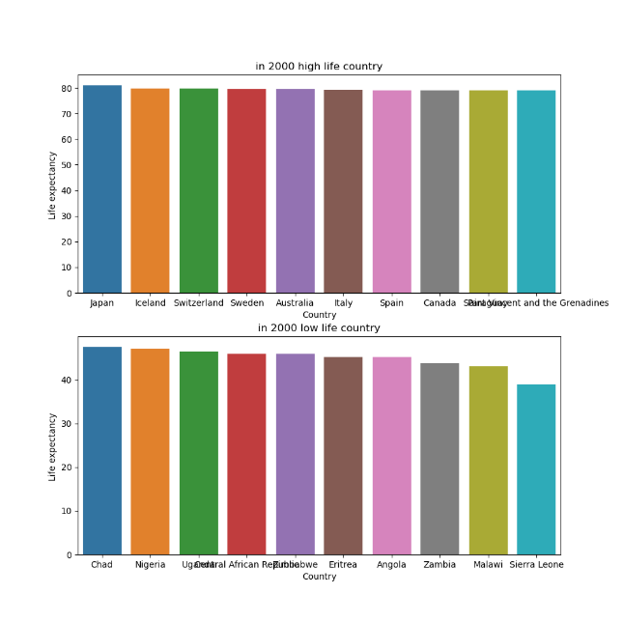
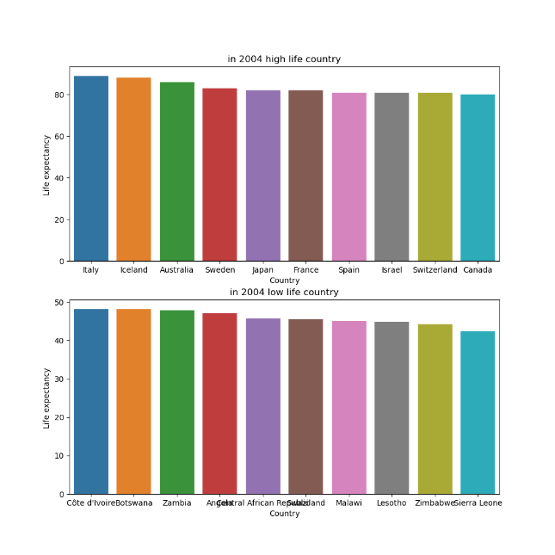
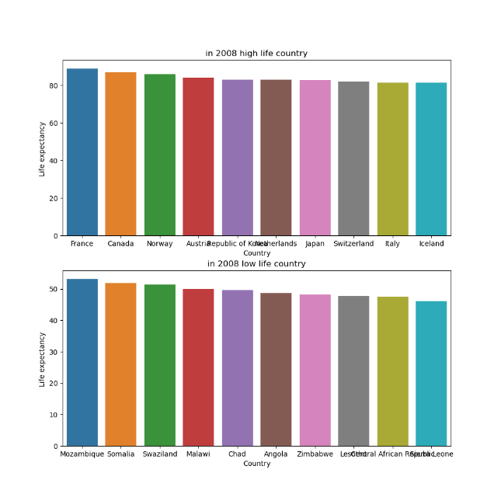
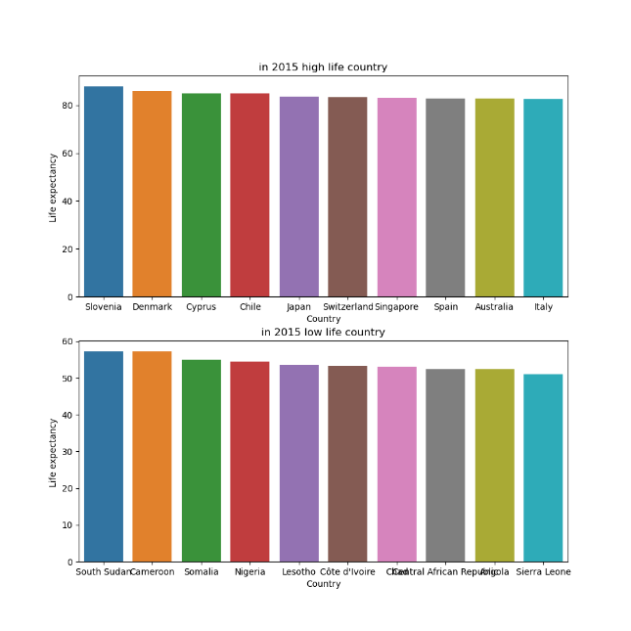
Health level vs Life Expectancy
Time
- Average age of Top 10 and Bottom 10 countries : 2000’s，2004’s, 2008’s, 2015’s
Developed Countries:
Life Expectancy in Developed Countries in 2000: In 2000, the average life expectancy in developed countries was approximately 76.3 years for both sexes combined. For males, it was around 73.9 years, while for females, it was approximately 78.7 years.
Life Expectancy in Developed Countries in 2004: By 2004, the average life expectancy in developed countries had increased to around 77.9 years for both sexes combined. For males, it was approximately 75.4 years, and for females, it was around 80.4 years.
Developing Countries:
Life Expectancy in Developing Countries in 2000: In 2000, the average life expectancy in developing countries was approximately 65.3 years for both sexes combined. For males, it was around 63.5 years, while for females, it was approximately 67.2 years.
Life Expectancy in Developing Countries in 2004: By 2004, the average life expectancy in developing countries had increased to around 66.5 years for both sexes combined. For males, it was approximately 64.8 years, and for females, it was around 68.3 years.

Slide 8
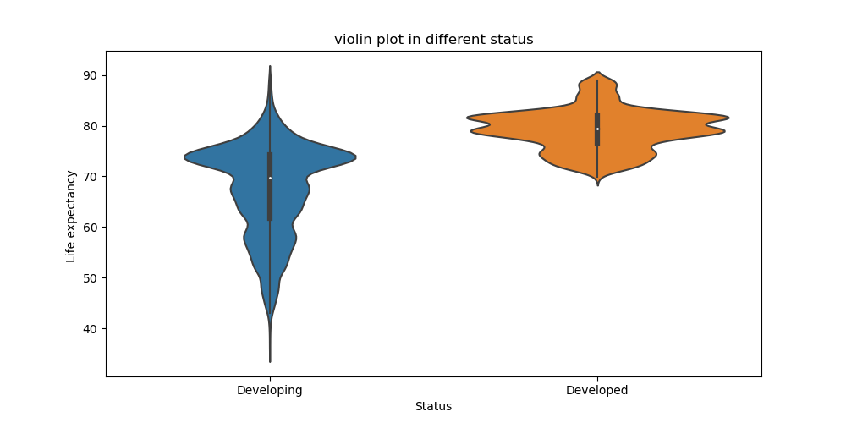
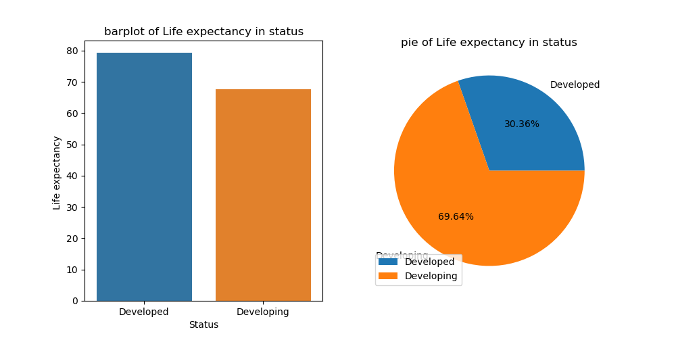
Health level vs Life Expectancy
Developed country vs developing country
There is generally a difference in life expectancy between developing countries and developed countries.
Developed countries tend to have higher life expectancies compared to developing countries.
Reason:
Healthcare Systems: Developed countries often have more advanced healthcare systems, with better access to quality healthcare services
Nutrition and Food Security: Developed countries often have better food security and access to a varied and nutritious diet.
Disease Burden: Developing countries often face a higher burden of infectious diseases
Public Health Infrastructure: Developed countries typically have well-established public health systems that focus on disease prevention, health promotion, and surveillance.

Slide 9
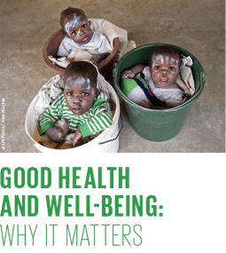
Possible solution
Health level vs Life Expectancy
Some suggestions
to enhance health services and contribute to longer life expectancy:
Universal Healthcare Coverage: Strive for universal healthcare coverage to ensure that everyone has access to essential healthcare services without financial hardship.
Primary Healthcare: Strengthen primary healthcare systems by focusing on preventive care, early detection, and management of common illnesses.
Disease Prevention and Health Promotion: Implement comprehensive public health initiatives aimed at disease prevention and health promotion.
Accessible and Affordable Medicines: Ensure the availability and affordability of essential medicines, particularly for chronic diseases
Health Information Systems: Establish robust health information systems to gather accurate and timely data on health indicators, disease patterns, and health service utilization.

Slide 10

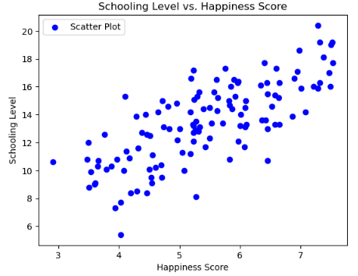
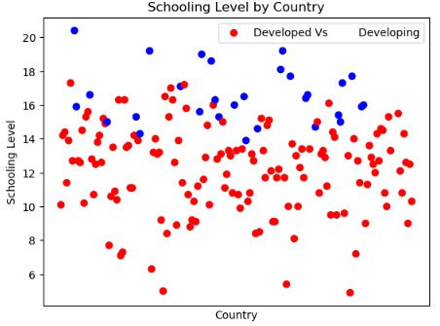

How Does Schooling Effect Happiness?
Insights
Schooling level has a clear impact on a country's happiness, as seen in figure 1. We can see the incline as the years of schooling increases.
The happiness score for a country is 4.15 when schooling is completed under 10 years, increases to 5.13 for completion between 10 and 15 years, and further rises to 6.35 for completion of 15 or more years of schooling.
When comparing developed and developing countries, schooling level was significantly impacted by a country falling in the developed category.
On average developed countries had a happiness score of 6.44 vs 5.11 for developing countries. A similar differential is seen in the completion of school years shown through 16.53 and 12.2 for developed vs developing countries.
Fig 1
Fig 2
Possible Solutions
Implement happiness programs in developing countries to improve overall happiness levels and increase students' likelihood of completing further schooling.
Increase investments in education, particularly in developing countries, to provide better infrastructure, resources, and opportunities for students.
Address socioeconomic disparities within and between countries to create a more conducive environment for students to pursue higher levels of education, regardless of their happiness levels.
Notes:
Cam

Slide 11
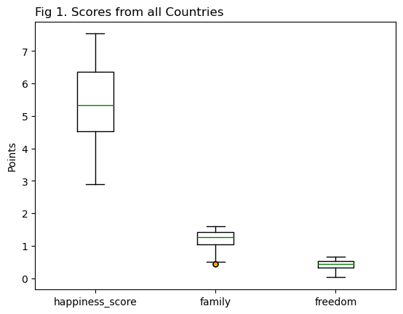
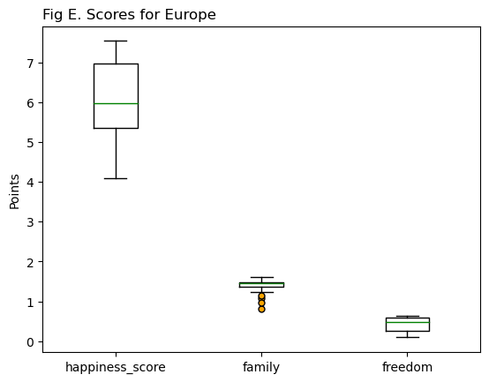
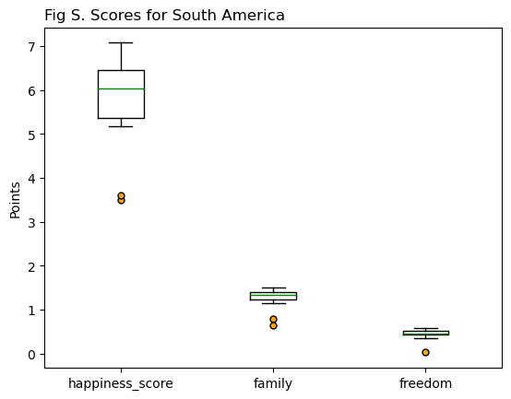
Happiness Score, Family & Freedom
Fig E. Scores from Europe
4 European countries are shown to be possible outliers for their low scores in happiness from family & social support. Albania, Bosnia and Herzegovina, Croatia and Romania
Fig S. Score for South America
South American has outliers in all results, both Haiti & Guinea (Guyana) lie in the extreme lower region of data for overall happiness, family & social connection, and Haiti also sits below the general data range for freedom to make life choices
Fig 1. Scores from all Countries
2 West African countries are shown to be possible outliers for their low scores in happiness from family & social support
Benin at 0.435 & Togo at 0.432 sit below the Family median of 1.27
Limitations
Comparing the raw scores for family & social connections, and freedom to make life choices between the 122 countries may not give a good assessment for the impact these factors have on overall happiness, so next we will look at how these two factors contribute to the happiness scores of their countries
Notes:
Paula Looking at the distribution of overall happiness score and the family & freedom components we can start to see some interesting details
Fig1 shows only 2 outliers
Benin & Togo are neighbouring West African countries that are situated between Ghana & Nigeria.
They show to fall below the lower bounds of the scores for family & social support
Looking more closely at countries within the same region we can see from
Fig E which captures 34 European countries has 4 countries sitting below the lower bounds for family & social support
Fig S for the 18 South American countries we have 2 falling well outside the lower range of the data for both overall happiness and family & social support, they are Guyana and Haiti, Haiti also falls well below for freedom to make life choices.
There are limitations to using the raw scores to show impact on happiness and life expectancy so on the next slides we have explored further utilising the percentage these factors have contributed to their country's happiness score.

Slide 12
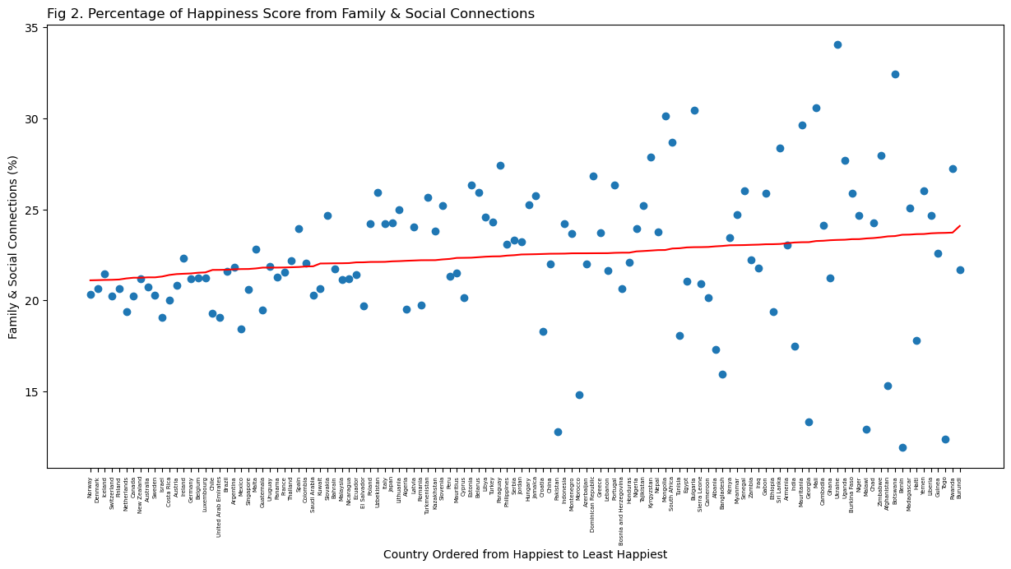
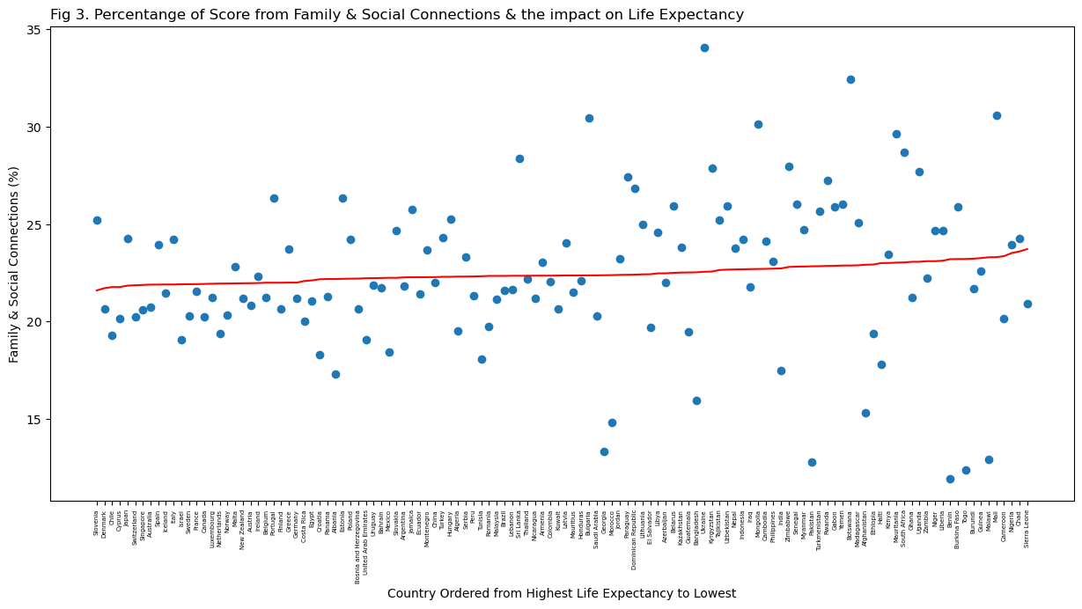
Impact of Family & Social Connections
“If you were in trouble, do you have relatives or friends you can count on to help you whenever you need them, or not?”
Happiness
Fig 2. Percentage of Happiness Score from Family & Social Connections
No relationship can be made between the proportion of happiness obtained from access to family & social connections and a counties overall happiness score
Comparing the top 20 ranked counties to those in the bottom 20 it can be seen that happiness plays a higher role in overall happiness
Top 20 has a mean of 20.54%
Bottom 20 has a mean of 23.0%
Life Expectancy
Fig 3. Percentage of Score from Family & Social Connections & the impact on Life Expectancy
- There can be no connection made between life expectancy and how high the impact of family & social connection is to a country's happiness score
Although no connection can be made on the impact that family & social connections has on either overall happiness or life expectancy the percentage that this variable contributes to a countries score highlights the importance for people's access to communication with their family and social support networks.
Note: Due to the decision to plot these using the country on the x-axis rather than happiness score the linear regression may appear bumpy. This does not retract from the result as the countries have been ranked from highest to lowest.
Notes:
Paula The question asked was
“If you were in trouble, do you have relatives or friends you can count on to help you whenever you need them, or not?”
Social support, or having someone to count on in times of trouble
This was recorded as a binary yes/no response.
Looking at Fig2 which has an r-value of 0.035 we can draw no correlation between the contribution of family & social connection and overall happiness
Although we can see, when looking at either end of this data, in the top 20 happiest countries have a mean of 20.54% and the bottom 20 countries rely a little higher on their access to social support with a mean of 23%
Fig 3 also shows us that we can derive no relationship between contribution of family & social support on overall happiness
Although no connection can be made on the impact of these factors on either overall happiness or life expectancy the large percentage that this factor contributes to a happiness score highlights the importance for people’s access to communication with their family and social support networks

Slide 13
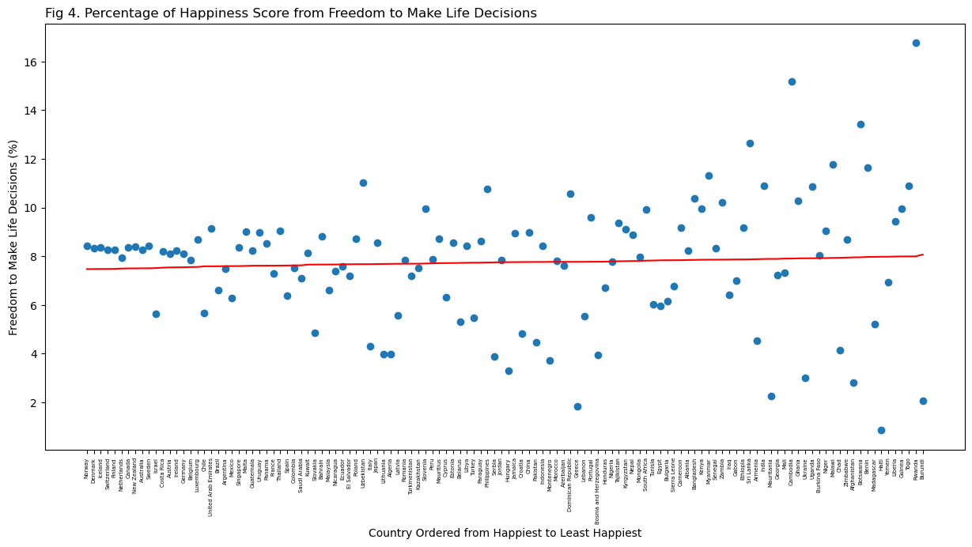
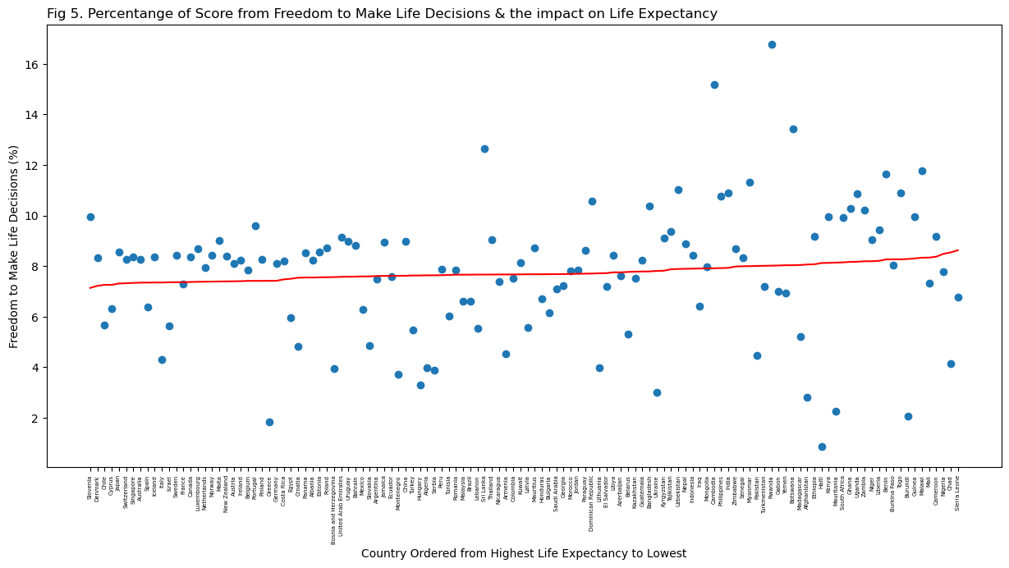
Impact of Freedom to Make Life Decisions
““Are you satisfied or dissatisfied with your freedom to choose what you do with your life?”
Happiness
Fig 4. Percentage of Happiness Score from Freedom to Make Life Decisions
No association can made between how happy a country is rated and how much of their happiness is received from their sense of freedom to make life decisions
The variation in percentage from freedom is most notable in the least happy countries. The two countries ranked lowest on the happiness score are examples of this with Rwanda having 16.76% of their happiness score made up of freedom to make life decisions and neighbouring African country Burundi with only 2.06%
Life Expectancy
Fig 5. Percentage of Score from Freedom to Make Life Decisions & the impact on Life Expectancy
No link can be made between life expectancy and how much of their happiness is received from their sense of freedom to make life decisions
Having no correlation between Freedom and Happiness or Life Expectancy and with no suggestions to give towards the political and cultural ways of any country we leave a quote from the World Happiness Report and support its stance on Human Rights.
“Human Rights. Inherent to all human beings, regardless of race, sex, nationality, ethnicity, language, religion, or any other status. Human rights include the right to life and liberty, freedom from slavery and torture, freedom of opinion and expression, the right to work and education, and many more. Everyone is entitled to these rights without discrimination”
Note: Due to the decision to plot these using the country on the x-axis rather than happiness score the linear regression may appear bumpy. This does not retract from the result as the countries have been ranked from highest to lowest.
Notes:
Paula The question asked was
“Are you satisfied or dissatisfied with your freedom to choose what you do with your life?”
Again, this was recorded as a binary response yes/no
Fig 4. & 5 both happiness and life expectancy show no link between the contribution of freedom to make life decisions.
Interestingly if we look at the last 2 countries in happiness order the variation in contribution is extreme with Rwanda at 16.76 and Burundi at only 2.06%
This also includes Human Rights. Inherent to all human beings, regardless of race, sex, nationality, ethnicity, language, religion, or any other status. Human rights include the right to life and liberty, freedom from slavery and torture, freedom of opinion and expression, the right to work and education, and many more. Everyone is entitled to these rights without discrimination.
Happiness – r-value 0.0033
Overall Mean = 7.74
Top 20 mean = 7.96
Bottom 20 mean = 8.54
Life Expectancy – r-value 0.016
Overall mean = 7.74
Top 20 mean = 7.75
Bottom 20 mean = 8.11

Slide 14
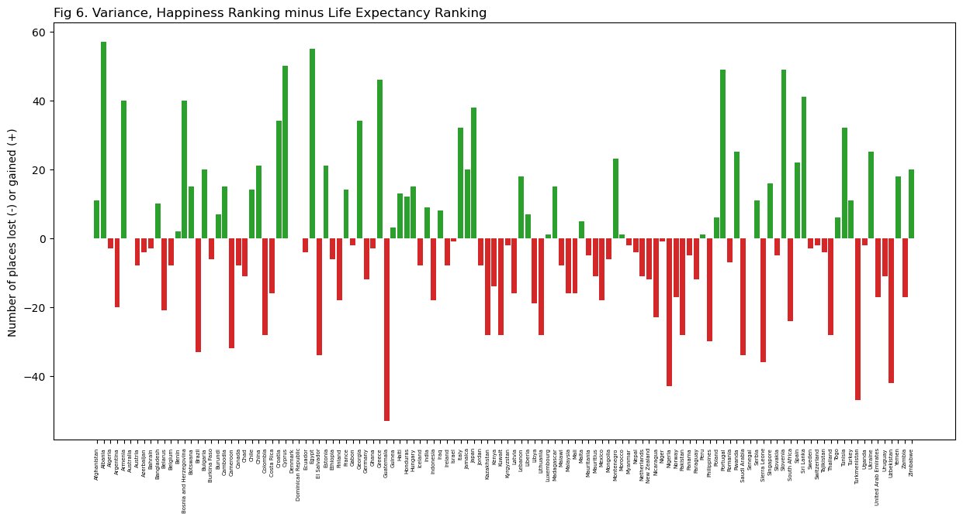
Top 5 Ranked Countries from our Data Sets
Fig 6. Variance, Happiness Ranking minus Life Expectancy Comparing the change in rank (Happiest to Least Happy vs Longest Life Expectancy to Shortest) we can see that most countries shifted position. 19 countries, including Brazil & Pakistan ranked more than 20 spots higher on Happiness, and 20 countries, including Italy & Ukraine ranked more than 20 spots higher on Life Expectancy
Ex 1 Albania
Ranked 87th on Happiness with a score of 4.644
Moved up 57 places to 30th on the Life Expectancy ranking with an age of 77.8yrs
Ex 2 Guatemala
Ranked 24th on Happiness with a score of 6.454
Moved down 53 places to 77th on the Life Expectancy ranking with an age of 71.9yrs
Top 5 Happiest Countries
Norway
Denmark
Iceland
Switzerland
Finland
Top 5 Countries for Life Expectancy
Slovenia
Denmark
Chile
Cyprus
Japan
Ex 1
Ex 2
Notes:
Juanita
Go Denmark
Let’s talk about the correlation between Happiness and Life Expectancy as outlined in Figure 6. What this graph shows is that 19 countries, including Brazil and Pakistan, have moved more than 20 spots higher in the Happiness Ranking in comparison to their Life Expectancy Ranking. In the same way, 20 countries, such as Italy & Ukraine, have moved more than 20 places higher in the Life Expectancy Ranking.
Let’s look at a couple examples. According to this graph, Albania moved up 57 places on the Life Expectancy Ranking, from 87th to 30th and also increased their life expectancy to 77.8 years.
In contrast, Guatemala has a Happiness Ranking of 24th with a score of 6.454, but their Life Expectancy Ranking has moved down 53 places to 77th with an age of 71.9yrs.
Finally, the top five countries with the highest Happiness Ranking are Norway, Denmark, Iceland, Switzerland, and Finland, whereas the five countries with the highest Life Expectancy are Slovenia, Denmark, Chile, Cyprus, and Japan.

Slide 15
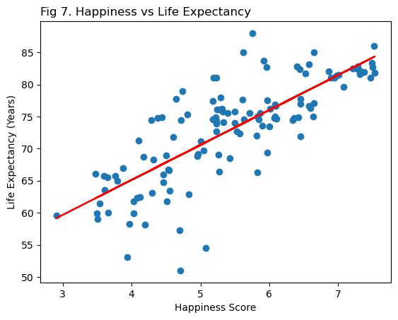
Conclusion: Increased Happiness can have a positive impact on Life Expectancy.
Summary of Findings
Education is crucial for a long and fulfilling life, as it correlates with higher happiness and longevity.
Higher GDP per capita in countries leads to increased happiness and longer life spans, emphasizing the importance of wealth in these aspects.
A well-developed healthcare system, disease prevention, affordable medicine, and comprehensive healthcare services contribute to longer and happier lives.
While social support and freedom of choice alone may not guarantee happiness or longevity, they still hold significance and require attention from decision-makers.
Fig 7. Happiness vs Life Expectancy
A strong correlation between happiness and life expectancy is found
R-value 0.61
Notes:
Paula Note about some of the big changes.

Slide 16

Thank You Cameron, Joey, Juanita and Paula
Notes:
Joey

